Slide 1
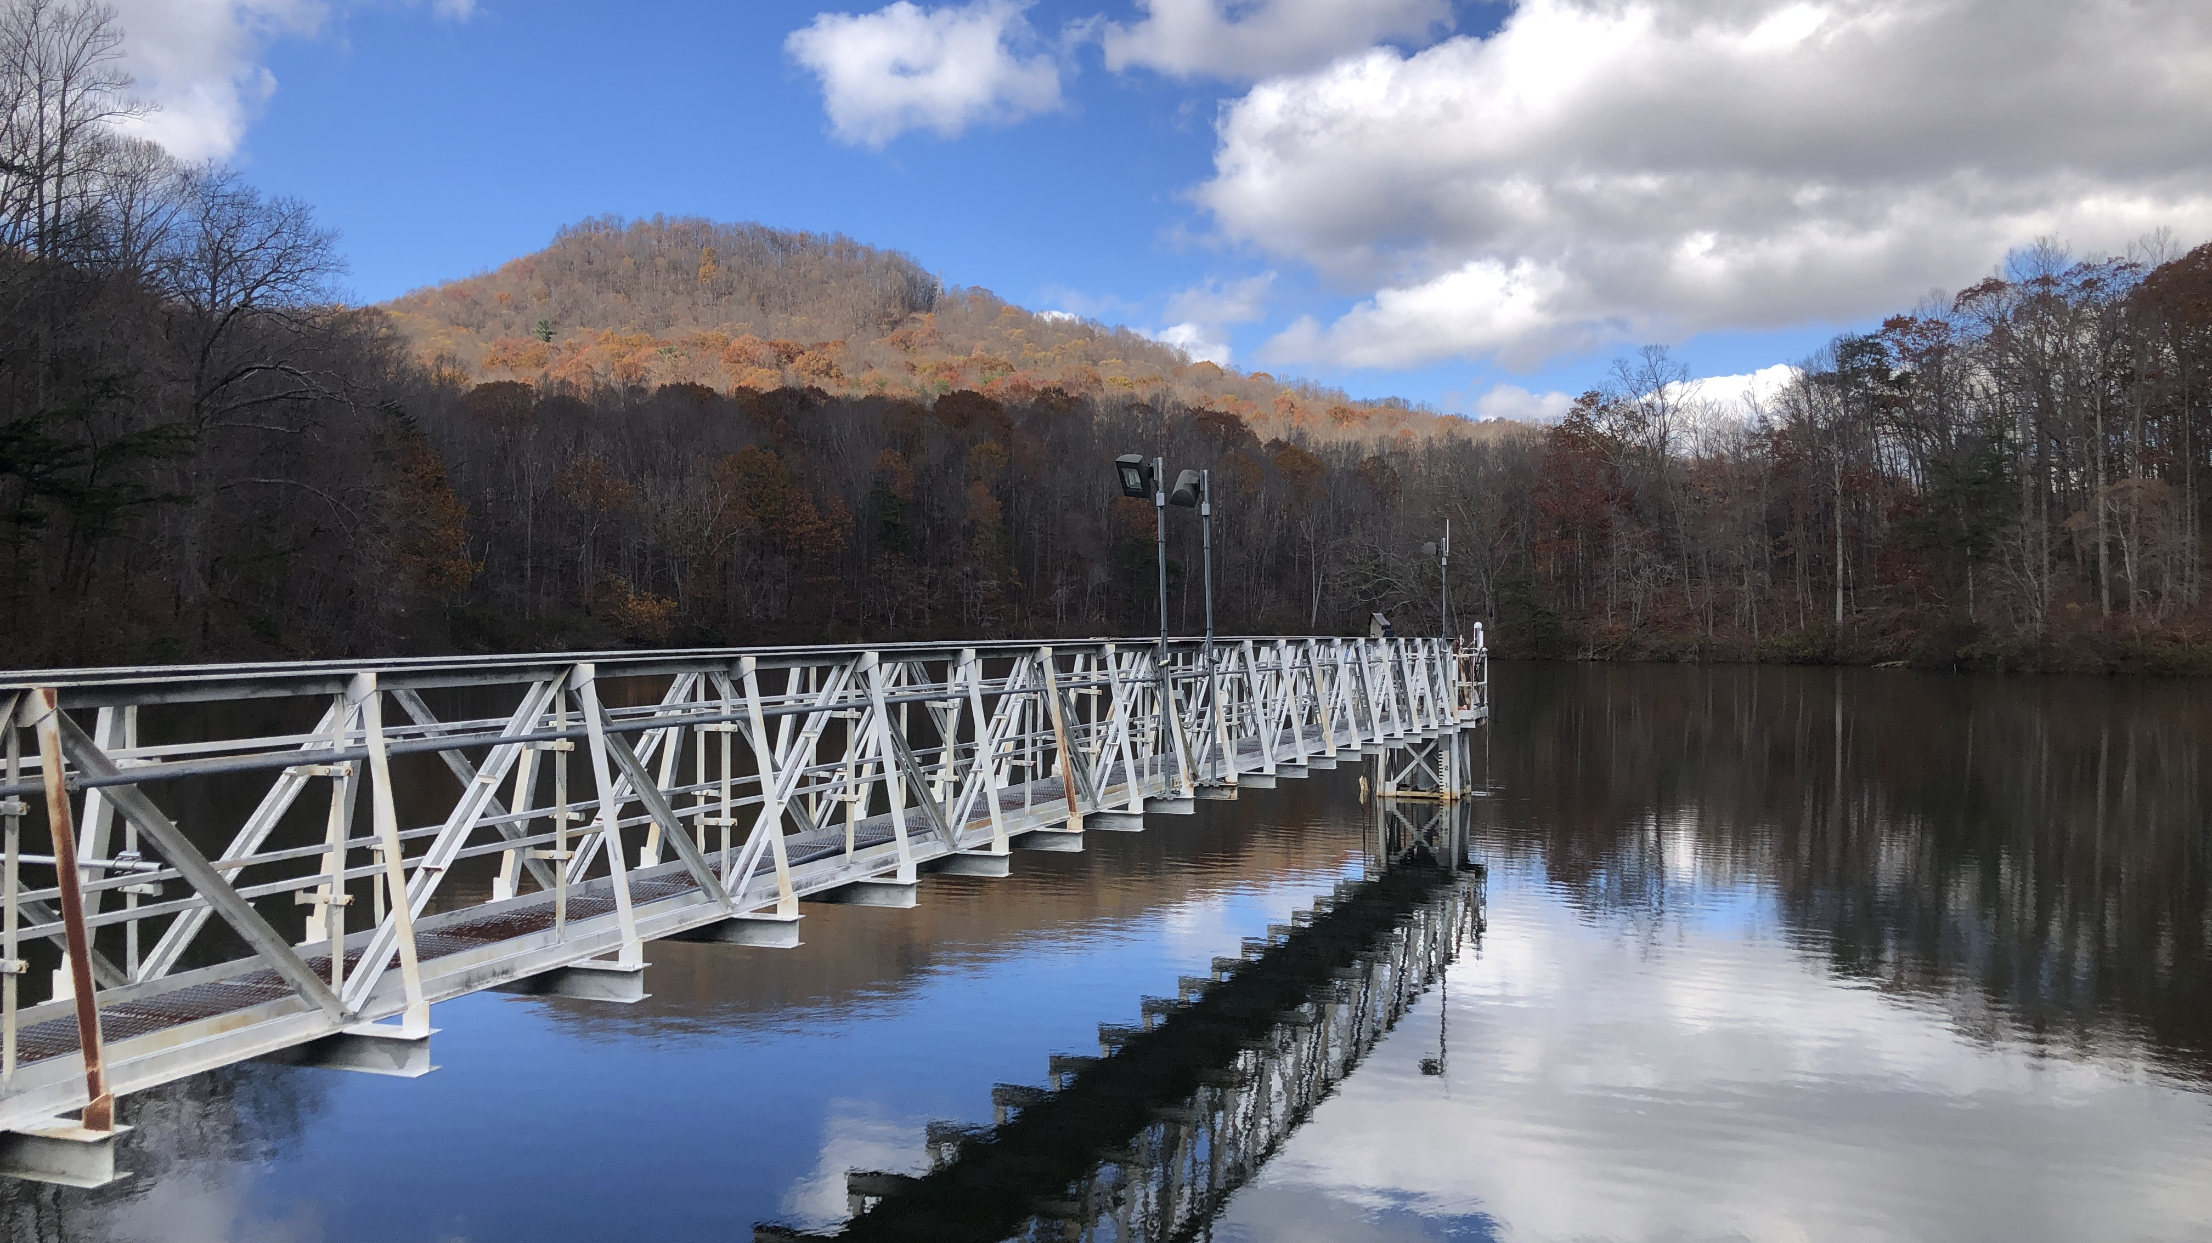
INTEGRATED WHOLE-ECOSYSTEM EXPERIMENTS AND ECOSYSTEM MODELING REVEAL THAT SEASONAL OXYGEN DEPLETION IS DRIVEN PRIMARILY BY TEMPERATURE IN A EUTROPHIC RESERVOIR Abigail Lewis, Ryan McClure, Paul Hanson, and Cayelan Carey
@lewis_lakes
Notes:
Hi, my name is Abby Lewis and today I am going to be talking about a project I led that INTEGRATED WHOLE-ECOSYSTEM EXPERIMENTS AND ECOSYSTEM MODELING to understand SEASONAL OXYGEN DEPLETION IN A DRINKING WATER RESERVOIR

Slide 2
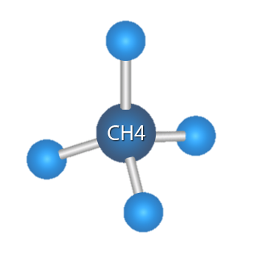
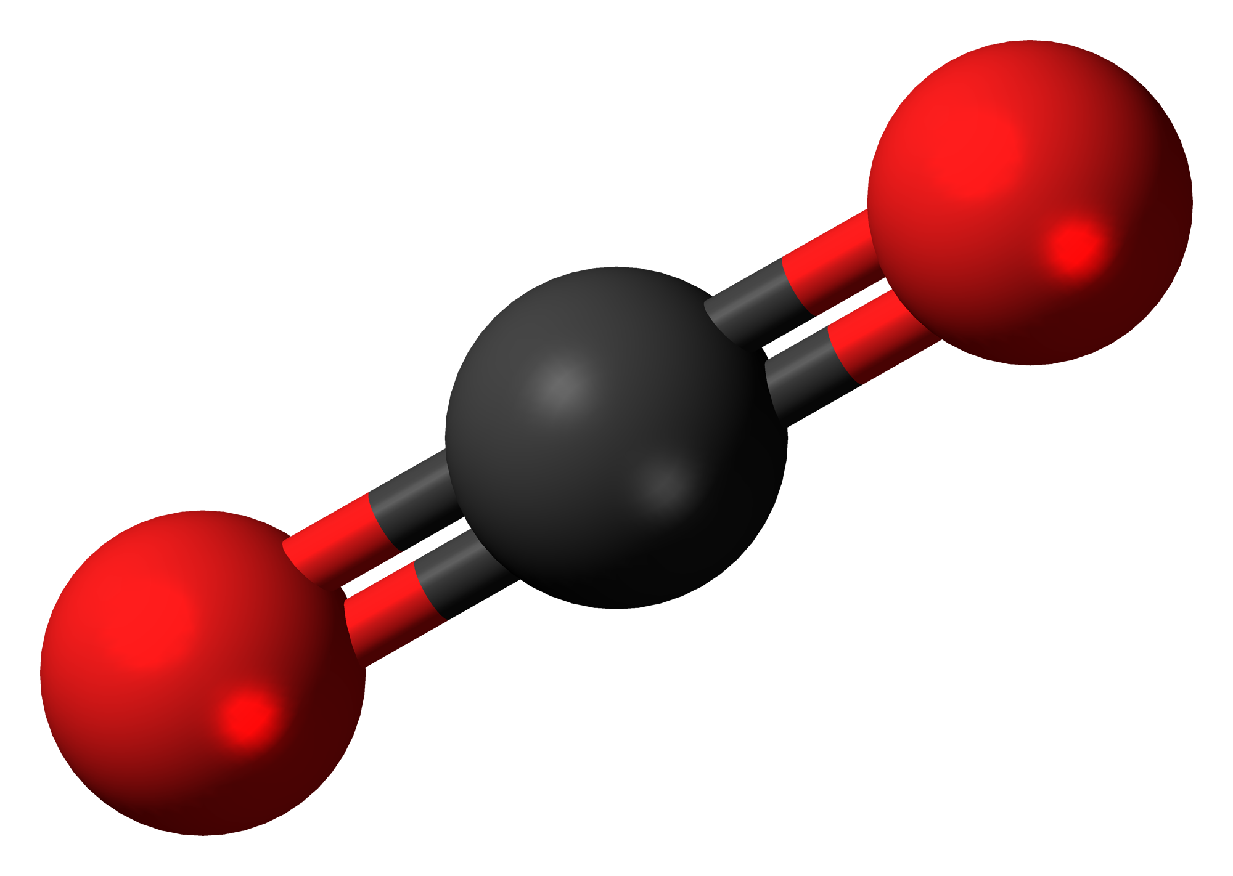
Both water quality and carbon burial in reservoirs depend on oxygen demand
CO₂
Notes:
In my talk I start off by emphasizing that the extent to which reservoirs are able to provide safe drinking water or serve as a carbon sink in the landscape depends on the rate of oxygen demand
High rates of biological oxygen demand mean that more carbon is being mineralized, increasing GHG production and potentially increasing carbon emissions from reservoirs. High rates of oxygen demand can also cause oxygen concentrations to decrease to the point where you see deteriorating water quality or release of nutrients such as nitrogen and phosphorus which cause harmful algal blooms.

Slide 3


More information is needed to determine how these factors interact in lakes and reservoirs
≠
Notes:
Previous research has used small-scale incubations to identify various factors that control the rate of oxygen demand. However, more information is needed to determine how these factors interact in lakes and reservoirs

Slide 4
How do temperature and oxygen interact to determine the rate of oxygen demand at the scale of a whole reservoir?
Notes:
Consequently, our focal question for this study was “How do temperature and oxygen interact to determine the rate of oxygen demand at the scale of a whole reservoir?“

Slide 5
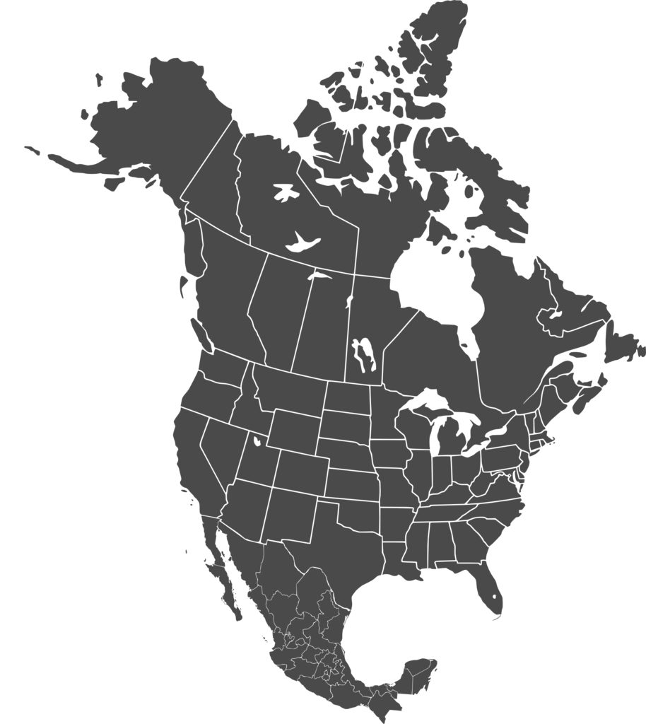

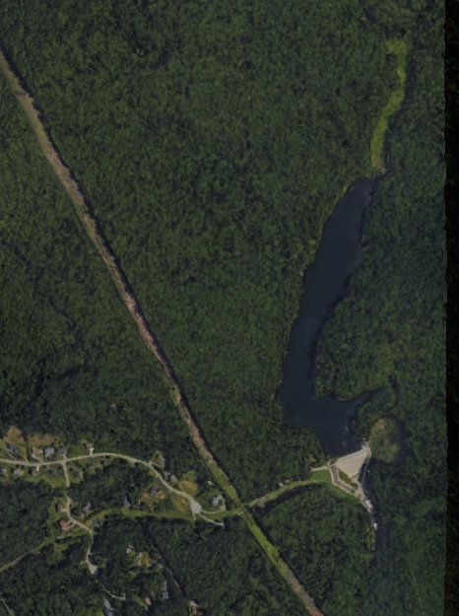
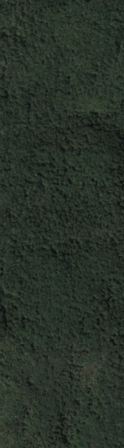
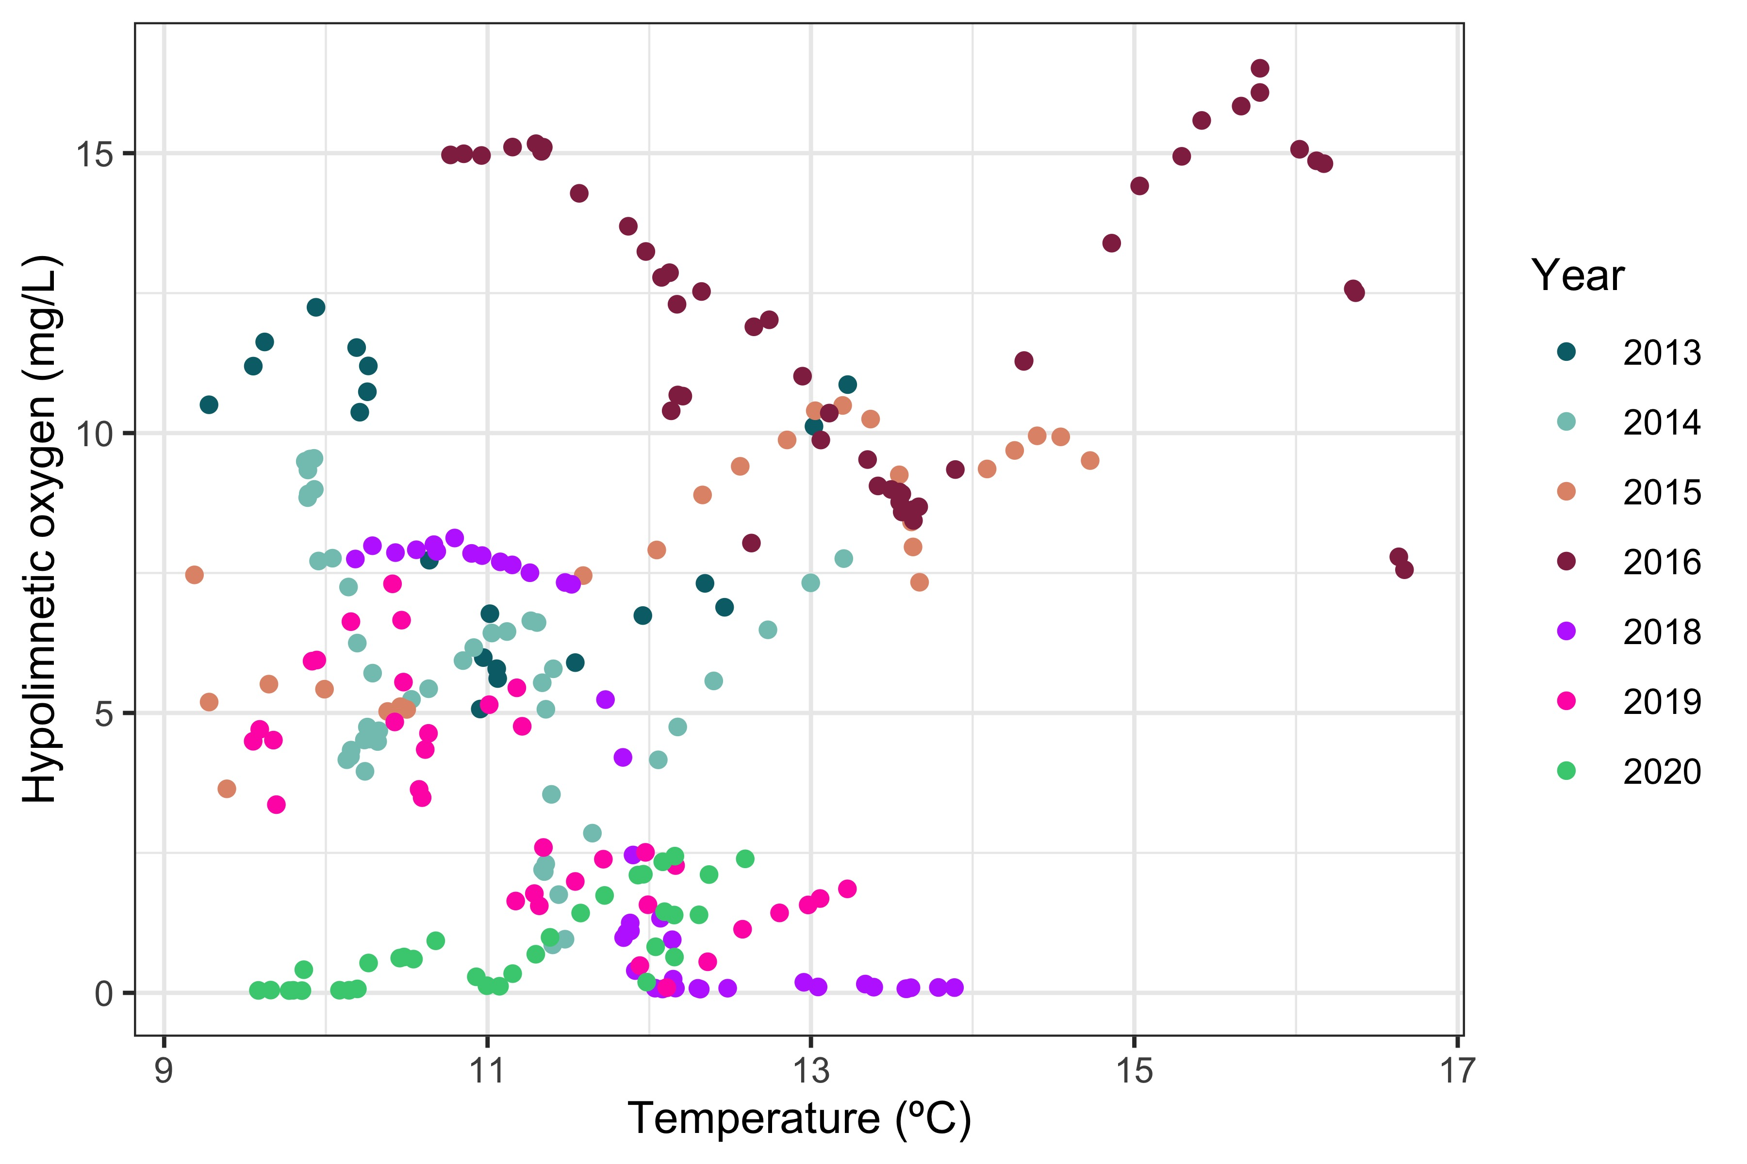
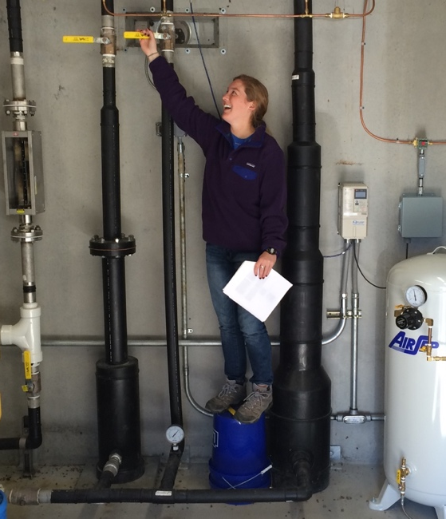

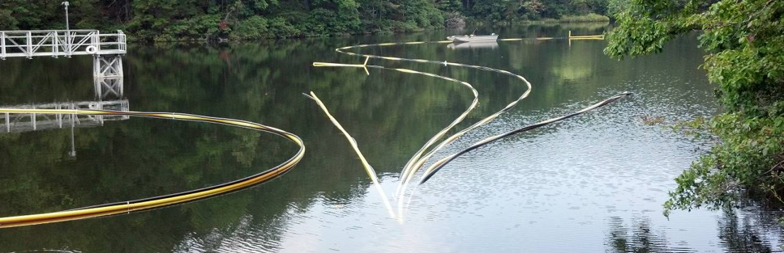
Eight years of oxygenation have provided a unique opportunity to analyze these factors on a whole-ecosystem scale
Falling Creek Reservoir
1 km
Notes:
To address this question, we used data from Falling Creek Reservoir, which is located in Southwest VA. Falling creek is a useful study site for this question, because it is equipped with a hypolimnetic oxygenation system that allows us to experimentally alter oxygen concentrations in the bottom waters of the reservoir, without decreasing thermal stability.
You can see that oxygenation system in this picture at the bottom. The oxygenation system operates at the bottom of the reservoir, but we had a perfect photo opportunity when we brought the system up to the surface for maintenance.
Oxygenation can be turned on and off on demand by scientists and managers, as shown in the picture above.
Starting in 2013, this oxygenation system has been operated on a variable schedule, providing a perfect dataset that disentangles seasonal correlations between oxygen concentrations and temperatures, helping us isolate the separate impacts of oxygen and temperature on oxygen demand.

Slide 6



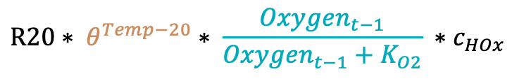
Alternative model structures test the importance of two drivers of oxygen demand
Full model
Oxygenation System
Oxygen Demand
$${DO}_{t}={DO}_{t−1}+HOx −oxygen demand$$
O₂
O₂
O₂
$$R20∗ θ^{Temp−20}∗ \frac{{Oxygen}_{t−1}}{{Oxygen}_{t−1}+K_{O2}} ∗c_{HOx}$$
Temperature-only model
Oxygen-only model
$$oxygen demand= R20∗ \frac{{Oxygen}_{t−1}}{{Oxygen}_{t−1}+K_{O2}} ∗c_{HOx}$$
$$oxygen demand= R20∗ θ^{Temp−20} ∗c_{HOx}$$
Training: 2013–2017 (parameters selected using CMAES). Test: 2018–2020
Notes:
To analyze these data, we created a model of oxygen demand, where oxygen demand is dependent on….
We then took the original model that contained sensitivity to both temperature and oxygen, and I divided it into two separate models to analyze the dominant drivers of oxygen demand. The temperature-only model included temperature as a driver, but not oxygen concentrations, and the oxygen-only model included oxygen as a driver, but not temperature. We chose this process-based approach rather than typical multiple linear regression approaches due to the substantial body of literature which has suggested these non-linear relationships between temperature, oxygen, and oxygen demand.

Slide 7
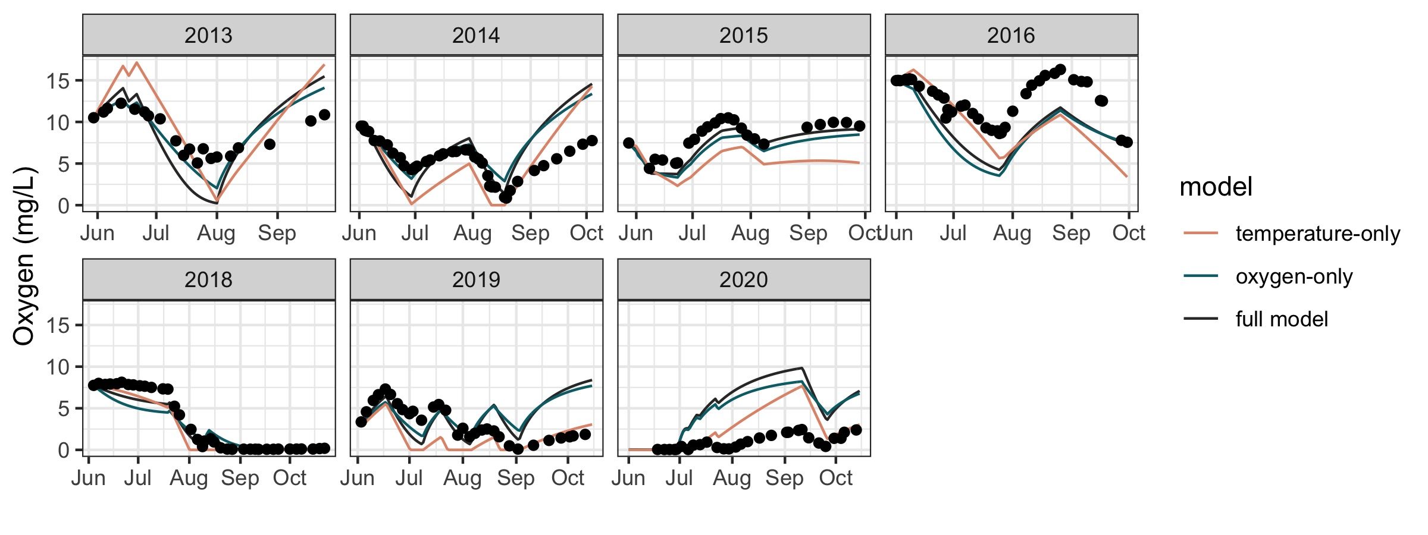
Temperature-only model outperforms oxygen-only model and full model in test years
Notes:
In this figure you can see observations (plotted as points) compared to model predictions (plotted as lines) over the entire time series of data.
Training vs testing
temperature only model does best at recreating the late summer oxygen increases, while the other models underestimate oxygen demand and over-estimate concentrations in that time period

Slide 8
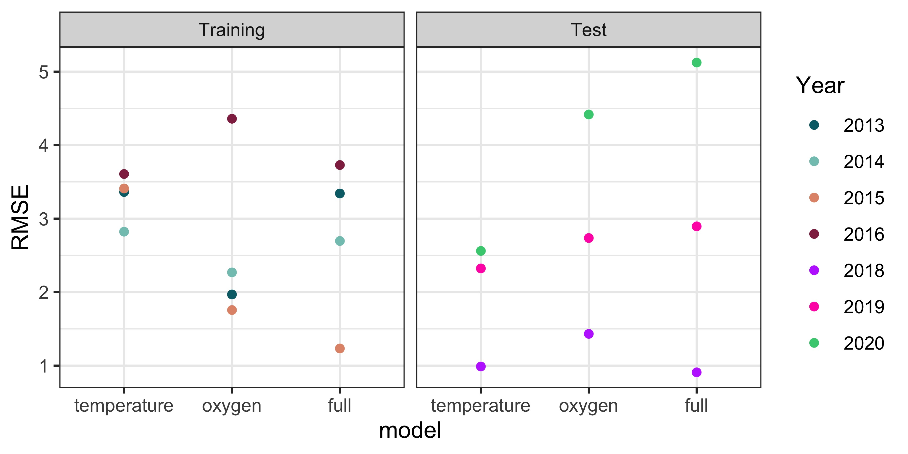
Temperature-only model outperforms oxygen-only model and full model in test years
Notes:
Anoxic period makes it more predictable in 2018
COD leads to issues in 2019, 2020

Slide 9
Conclusions
Changing temperatures may dramatically alter oxygen conditions in lakes and reservoirs
Oxygen demand may be sensitive to oxygen concentrations in the absence of oxygenation
Next steps:
Refine model comparison process
Incorporate chemical oxygen demand
Notes:
So overall, through this project we have found that the temperature-only model performed better than either the oxygen-only model or the full-model, suggesting that changing temperatures may dramatically alter oxygen conditions in lakes and reservoirs.
Moving forward, I am now working to
Refine model comparison process considering additional models and further exploring the circumstances under which each model performs best
Incorporate chemical oxygen demand, which may be driving poor model performance under oxic conditions
While more work is needed, through this project, we have already begun to develop a better understanding relative importance of temperature and oxygen concentrations as drivers as oxygen demand on a whole ecosystem scale. Through this work we are helping to better predict how water quality and carbon cycling in reservoirs, will change over time.

Slide 10
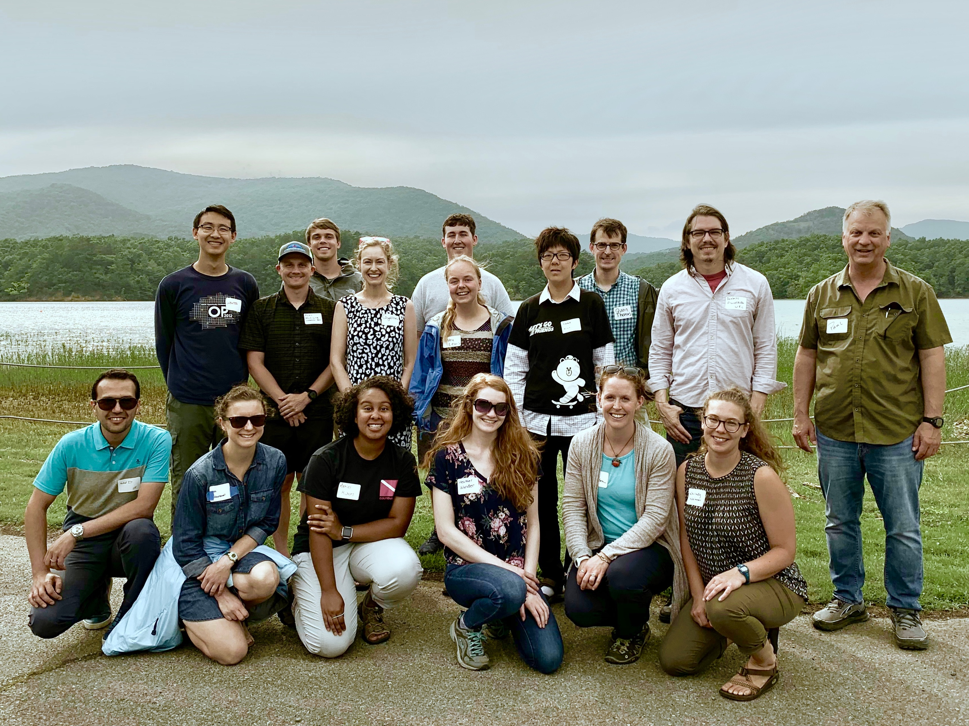


aslewis@vt.edu
@lewis_lakes
Notes:
I want to thank the Carey lab for collecting all of these data over the past six years, and the western Virginia water authority for allowing us to do work in their beautiful reservoirs. Thanks everyone for listening, and I’m happy to take any questions!

